Slide 1
Detectable.
Treatable.
Beatable.

Slide 2

Bowel Cancer New Zealand (Inc)
Mission statement: We are a nationwide, patient-led organisation committed to reducing the impact of bowel cancer on our community through awareness, education and support.

Slide 3

Bowel cancer is the 2nd most commonly diagnosed cancer in New Zealand
3,000+ New Zealanders are diagnosed with bowel cancer every year
Bowel cancer is the second most common cancer diagnosed in NZ behind prostate cancer
New Zealand Ministry of Health (2016). Cancer: New registrations and deaths 2013. Wellington, New Zealand: Ministry of Health.

Slide 4



1,200+ New Zealanders die from bowel cancer every year¹
Bowel cancer is the second highest cause of cancer-related death in NZ¹
2nd to lung cancer overall¹
  2nd to lung cancer in males
  3rd to lung and breast cancer in females
The risk of mortality from bowel cancer
increases with age
1. New Zealand Ministry of Health (2016). Cancer: New registrations and deaths 2013. Wellington, New Zealand: Ministry of Health.

Slide 5

Bowel cancer affects people of all ages^{1,2}
Probability of developing bowel cancer by age²
1 in 50
Chance of developing bowel cancer by the age of retirement (65 years)²
New Zealand Ministry of Health (2016). Cancer: New registrations and deaths 2013. Wellington, New Zealand: Ministry of Health.
New Zealand Ministry of Health. Bowel Cancer – information at increased risk of bowel cancer. Available at: https://www.health.govt.nz/system/files/documents/publications/bowel-cancer-2012-update_consumer.pdf.

Slide 6
Bowel cancer affects people of all ages^{1,2}
Probability of developing bowel cancer by age²
1 in 25
Chance of developing bowel cancer by the age of
75 years²
New Zealand Ministry of Health (2016). Cancer: New registrations and deaths 2013. Wellington, New Zealand: Ministry of Health.
New Zealand Ministry of Health. Bowel Cancer – information at increased risk of bowel cancer. Available at: https://www.health.govt.nz/system/files/documents/publications/bowel-cancer-2012-update_consumer.pdf.

Slide 7
Regional distribution of bowel cancer
This figure is editable so that it can be adapted for individual regions to highlight the incidence, depending on the audience.
Age-standardised mortality per 100,000 population for bowel cancer
1. New Zealand Ministry of Health (2016). Cancer: New registrations and deaths 2013. Wellington, New Zealand: Ministry of Health.
Notes:
The highest rates of bowel cancer in Ne Zealand are found in the southern half of the South Island

Slide 8
Bowel cancer is an increasing health burden in Māori
Bowel cancer is the 3rd highest cause of cancer-related death among Māori^{1,2}
  Although bowel cancer is more common in non-Māori, annual incidence and mortality rates are increasing more rapidly in Māori¹⁻³
Age-standardised mortality per 100,000 population for bowel cancer²
If you are Māori and have any concerns about your bowel cancer risk, consider talking to your GP or Māori/Pacific Community Health worker
1. Robson B, Harris R (eds). 2007. Hauora: Maori Standards of Health IV. A study of the years 2000–2005. Wellington, New Zealand, Te Ropu Rangahau Hauora a Eru Pomare.
2. New Zealand Ministry of Health (2016). Cancer: New registrations and deaths 2013. Wellington, New Zealand: Ministry of Health.
3. Shah A, et al. ANZ J Surg 2004;82:258–264.

Slide 9
The incidence of bowel cancer in New Zealand is amongst the highest in the world...
Age-standardised incidence per 100,000 population for bowel cancer*
*In males; statistics from 2012.
ASR, age-standardised rate.
Stewart BW, Wild CP, editors (2014).World Cancer Report 2014. Lyon, France: International Agency for Research on Cancer.
Notes:
Globally, bowel cancer accounts for 10% of all cancers

Slide 10
...and mortality rates are high compared with other countries
Age-standardised mortality per 100,000 population for bowel cancer*
*In males; statistics from 2012.
ASR, age-standardised rate.
Stewart BW, Wild CP, editors (2014).World Cancer Report 2014. Lyon, France: International Agency for Research on Cancer.
Notes:
Bowel cancer causes 694,000 deaths worldwide each year

Slide 11
What is bowel cancer?

Slide 12
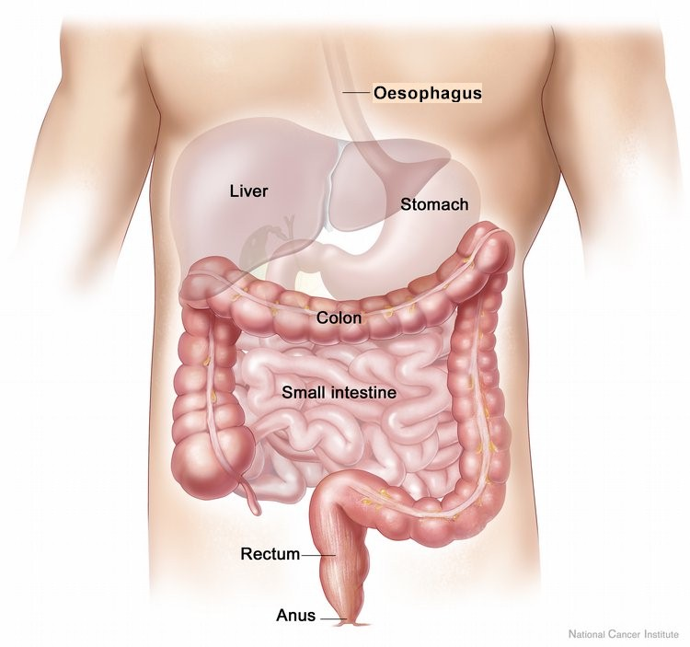
What is bowel cancer?
Bowel cancer involves the development of malignant growth(s)
in your colon, rectum or anus^{1,2}
New Zealand Ministry of Health. Bowel Cancer. Available at: https://www.health.govt.nz/your-health/conditions-and-treatments/diseases-and-illnesses/bowel-cancer.
New Zealand Ministry of Health. Bowel Cancer – information at increased risk of bowel cancer. Available at: https://www.health.govt.nz/system/files/documents/publications/bowel-cancer-2012-update_consumer.pdf.

Slide 13
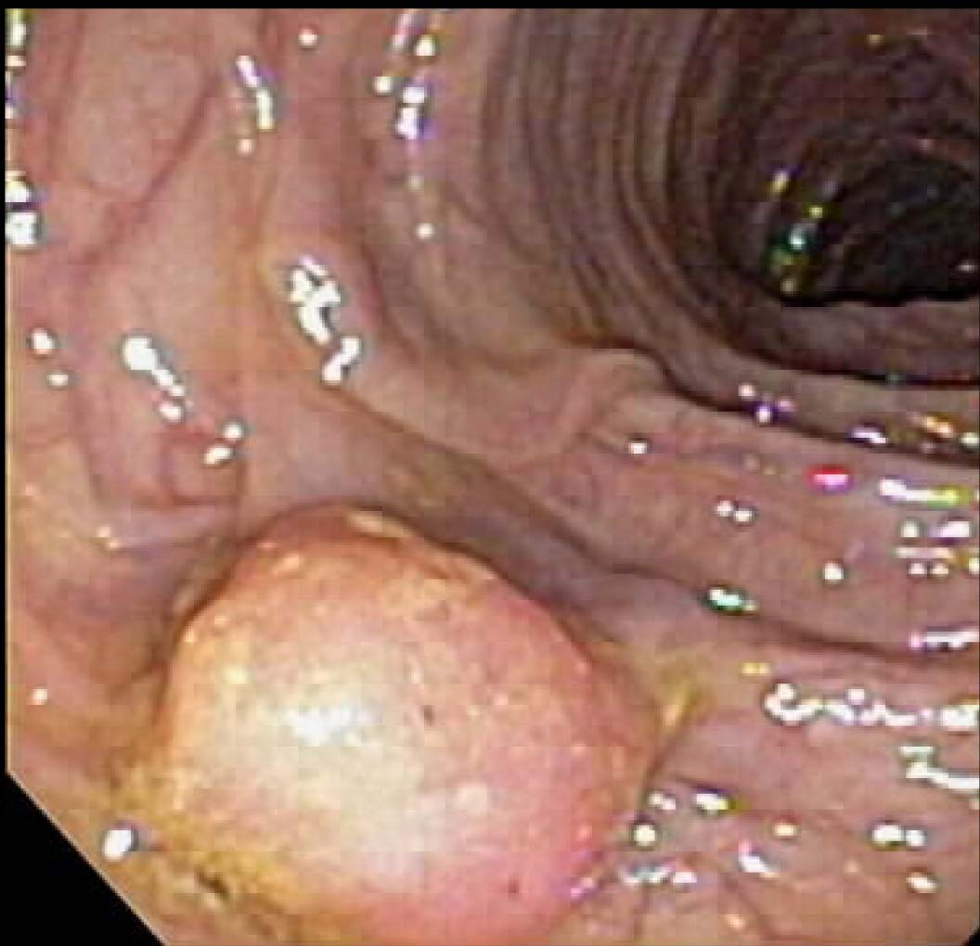
What is bowel cancer?
Bowel cancer usually starts as non-cancerous growth called a polyp
Polyps can develop into cancer if left untreated
New Zealand Ministry of Health. Bowel Cancer – information at increased risk of bowel cancer. Available at: https://www.health.govt.nz/system/files/documents/publications/bowel-cancer-2012-update_consumer.pdf.

Slide 14
30–40% of New Zealanders will develop polyps in their lifetime¹
The greater number and size of polyps
increases the chance of bowel cancer¹
It takes 5–10 years for abnormal cells
to develop into cancer¹
The likelihood of developing polyps
increases with age¹
  ~40%
  of polyps >2 cm will
  become malignant²
New Zealand Ministry of Health. Bowel Cancer – information at increased risk of bowel cancer. Available at: https://www.health.govt.nz/system/files/documents/publications/bowel-cancer-2012-update_consumer.pdf.
Amersi F, et al. Clin Colon Rectal Surg 2005;18:133–140.

Slide 15

Bowel cancer can be beaten.
If detected early, bowel cancer can be successfully treated in 75% of cases

Slide 16
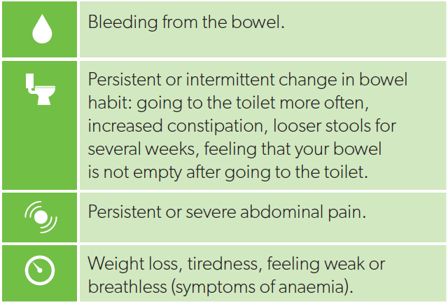
What are the symptoms of bowel cancer?
It can be embarrassing to talk about these symptoms but if any are persistent or intermittent, or you have any concerns about your bowel health, see your Health Professional/GP
1. Bowel Cancer New Zealand. Symptoms. Available at: http://beatbowelcancer.org.nz/about-bowel-cancer/symptoms/.

Slide 17

Not all patients will present with symptoms of bowel cancer
Risk factors for bowel cancer include:
  Being older than 50 years
  A personal or family history
  Genetic factors associated with bowel cancer
Bowel Cancer New Zealand. Bowel cancer screening. Available at: http://beatbowelcancer.org.nz/about-bowel-cancer/screening/.

Slide 18
Risk factors – Personal history
People with a personal history of the following are
at an increased risk of bowel cancer:
  A type of polyp known as an ‘adenomatous polyp’
  Inflammatory bowel disease
  (includes Crohn’s disease and ulcerative colitis)
  Previous bowel cancer
New Zealand Ministry of Health. Surveillance for people at increased risk of colorectal cancer. Available at: https://www.health.govt.nz/system/files/documents/publications/brochure-primary-care-colorectal-cancer.pdf.

Slide 19
Risk factors – Family history
A family history of the bowel cancer:
  One immediate family member* diagnosed with
  bowel cancer before 55 years
  OR two immediate family members of any age
  Familial colorectal cancers, including familial
  adenomatous polyps (FAP) and hereditary non-polyposis
  colorectal cancer (Lynch syndrome)
  An immediate family member with multiple adenomatous polyps
Mother
Father
Sister
Me
Brother
Children
*This includes a parent, sibling or child of the individual.
New Zealand Ministry of Health. Surveillance for people at increased risk of colorectal cancer. Available at: https://www.health.govt.nz/system/files/documents/publications/brochure-primary-care-colorectal-cancer.pdf.
Notes:
30% of people with bowel cancer have a family history or hereditary factors

Slide 20

Risk factors – Genetic factors
Some genes can increase the risk of bowel cancer
  Each gene has a different probability of causing disease
  Inheriting multiple low-risk susceptibility genes may confer an incrementally greater risk
Not all individuals with high-risk genes will develop bowel cancer
Screening for high-risk genes can help ensure an early diagnosis and treatment of bowel cancer
Valle L. World J Gastroenterol 2014;20:9828–9849.

Slide 21
Familial adenomatous polyposis (FAP)
FAP is caused by a genetic mutation in the APC gene
Patients with FAP generally have a large number of
adenomas in the bowel (more than 100)
  Adenomas are a type of benign tumour that can develop into cancer
If left untreated, patients with FAP almost always develop bowel cancer¹
APC
Patients with a family history of FAP should be screened for APC gene mutations to reduce the risk of bowel cancer
Aihara H, et al. Eur J Gastroenterol Hepatol 2014;26:255–262.

Slide 22

National Bowel Screening Programme
A free programme for men and
women aged 60–74 years^{1,2}
Can be performed every 2 years
for those eligible for public funding^{1,2}
Prior to screening, eligible individuals are
sent an invitation letter, a consent form and a free
bowel cancer screening kit (known as FIT)^{1,2}
Bowel Cancer New Zealand. Bowel cancer screening. Available at: http://beatbowelcancer.org.nz/about-bowel-cancer/screening/.
New Zealand Ministry of Health. National Bowel Screening Programme. Available at: https://www.health.govt.nz/our-work/diseases-and-conditions/cancer-programme/bowel-cancer-programme/national-bowel-screening-programme.

Slide 23

Faecal immunochemical test (FIT)*
Blood in stool can be an early sign of bowel cancer^{1,2}
FIT is a non-invasive, preliminary at-home testing
kit for detecting traces of blood in a stool sample^{1,2}
FIT is simple, clean and fast^{1,2}
The sample is sent to a laboratory for testing
Your doctor will advise you whether any
additional testing is required (e.g. colonoscopy)^{1,2}
*Also known as an immunochemical faecal occult blood test (iFOBT).
1. Bowel Cancer New Zealand. Bowel cancer screening. Available at: http://beatbowelcancer.org.nz/about-bowel-cancer/screening/.
2. National Screening Unit. About the bowel screening test. Available at: https://www.nsu.govt.nz/national-bowel-screening-programme/about-bowel-screening-test.
Notes:
You can also visit your local pharmacy to discuss self-screening and purchasing of a test kit (if you are not experiencing symptoms)

Slide 24
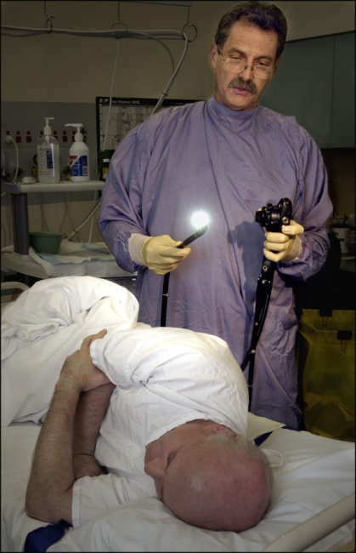
Colonoscopy
A colonoscopy is the most commonly used test
for checking the bowel for cancer
A colonoscopy involves inserting a thin tube with
a small camera into the anus to inspect the
large bowel
If polyps are identified, they may be removed and
sent to a laboratory for testing
1. New Zealand Ministry of Health. About bowel screening. Available at: https://www.health.govt.nz/our-work/diseases-and-conditions/cancer-programme/bowel-cancer-programme/national-bowel-screening-programme/about-bowel-screening.
Notes:
A colonoscopy is effective for detecting significant polyps and at least 95% of cancers

Slide 25
What happens if I am diagnosed with bowel cancer?

Slide 26
Staging bowel cancer
Following detection, it is important to assess the stage of the bowel cancer to inform treatment decisions
Staging is influenced by the size and spread of tumours
0
I
II
III
IV
New Zealand Cancer society. Staging. Available at: https://cancernz.org.nz/cancer-information/cancer-types/bowel-cancer/staging/.

Slide 27

How is bowel cancer staged?
Stage | Description | Lymph node involvement? | Metastases outside the bowel? | % of diagnoses*
I | Confined to the inner lining of the bowel or muscle wall, but no further. | ✗ | ✗ | 21%
II | Cancer has spread through the bowel wall | ✗ | ✗ | 29%
III | Cancer has spread to nearby lymph nodes and/or through the bowel wall, but not to other organs | ✓ | ✗ | 32%
IV | Cancer has spread to other organs (metastatic) | N/A | ✓ | 18%
*Based on US statistics between 2002–2012.
New Zealand Cancer Society . Staging. Available at: https://otago-southland.cancernz.org.nz/cancer-information/cancer-types/bowel-cancer/staging/.
Moghadamyeghaneh Z, et al. Surg Endosc 2016;30:3604–3610.

Slide 28
How is bowel cancer treated?
Stage | Colon | Rectum | Anus
I/II | Surgery | Treatment options include: Neoadjuvant (before surgery) radiotherapy and/or chemotherapy Surgery Adjuvant (post-surgery chemotherapy/radiotherapy
III | Surgery and adjuvant (post-surgery) chemotherapy
IV | Treatment options include: Surgery Chemotherapy Targeted therapies Specialised radiotherapy | Treatment options include: Neoadjuvant (before surgery) radiotherapy and chemotherapy Surgery Adjuvant (post-surgery chemotherapy Radiotherapy Targeted therapies
Bowel Cancer New Zealand. Treatment options. Available at: http://beatbowelcancer.org.nz/about-bowel-cancer/treatment/.

Slide 29
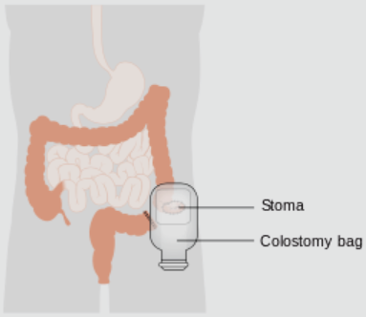
Treatment of early-stage bowel cancer
Surgery^{1,2}
Used to remove the segment of
the bowel containing cancer
10–20 lymph glands may be removed
to assess spread beyond the bowel
A colostomy bag may be needed
following surgery to facilitate excretion
Bowel Cancer New Zealand. Treatment options. Available at: http://beatbowelcancer.org.nz/about-bowel-cancer/treatment/.

Slide 30
Treatment of early-stage bowel cancer
Adjuvant chemotherapy¹⁻³
Adjuvant chemotherapy is used to attack any cancerous cells that remain after surgery, minimising the risk of recurrence
For every 100 patients treated for early stage bowel cancer, adjuvant chemotherapy ensures 7 more survive >3 years
Carrato A. Gastrointest Cancer Res 2008;2:S42–S46.
Wolmark N, et al. J Clin Oncol 1993;11:1879–1887.
Benson AB, et al. J Natl Compr Canc Netw 2014;12:1028–1059.
Notes:
Adjuvant chemotherapy is most often used for patients with Stage II or III bowel cancer

Slide 31
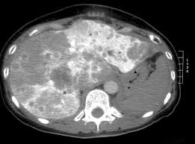
Metastatic bowel cancer^{1,2}
Up to 60% of patients diagnosed with bowel cancer develop metastases
Metastases are secondary malignant
growths in other organs
Imaging is essential for evaluating
the extent of any metastases
MRI showing metastases in the liver of a patient with bowel cancer
MRI, magnetic resonance imaging.
1. Benson AB, et al. J Natl Compr Canc Netw 2014;12:1028–1059.
Dhir M, Sasson AR. J Oncol Pract 2016;12:33–39.

Slide 32
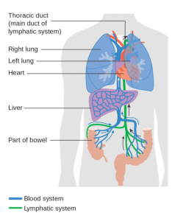
Metastatic bowel cancer^{1,2}
The liver is the most common site for
cancer metastases
  All blood from the bowel flows through
  the liver
  Metastases are limited to the liver in >50%
  of cases
Other common sites include the lungs
Benson AB, et al. J Natl Compr Canc Netw 2014;12:1028–1059;
Dhir M, Sasson AR. J Oncol Pract 2016;12:33–39.

Slide 33
Treating metastatic bowel cancer^{1,2}
Metastatic bowel cancer is not generally considered to be curable
Treatment aims to extend life and maintain quality of life
Treatment can include:
  Chemotherapy
  Targeted agents
  Surgery or radiotherapy may be used in select cases
Oncologists will perform a thorough assessment before deciding what is the most appropriate treatment for individual patients
Bowel Cancer New Zealand. Treatment options. Available at: http://beatbowelcancer.org.nz/about-bowel-cancer/treatment/.
Benson AB, et al. J Natl Compr Canc Netw 2014;12:1028–1059.
Benson AB, et al. J Natl Compr Canc Netw 2017;15:370–398.

Slide 34
Treatment of metastatic bowel cancer^{1,2}
Chemotherapy (indiscriminately) targets rapidly growing cells, such as cancer cells, generally by interfering with DNA replication
  Chemotherapy may be given in combination with targeted therapy or radiotherapy
Drugs | Mode of administration | Key adverse events
5-FU/LV Capecitabine Trifluridine/tipiracil (LONSURF®) | Intravenous infusion Oral tablet Oral tablet | Diarrhoea Nausea Fever
Irinotecan | Intravenous infusion | Diarrhoea Nausea/vomiting
Oxaliplatin | Intravenous infusion | Peripheral neuropathy (loss of sensation in the fingers/toes)
5-FU, 5-fluouracil; LV, leucovorin.
Benson AB, et al. J Natl Compr Canc Netw 2014;12:1028–1059.
Benson AB, et al. J Natl Compr Canc Netw 2017;15:370–398.

Slide 35

Treatment of metastatic bowel cancer^{1,2}
Targeted therapies can be used in combination with chemotherapy to improve treatment outcomes
Targets can include markers expressed by tumour cells or underlying mechanisms that drive tumour growth
Tests may be required to identify ‘biomarkers’
that indicate which therapies are suitable for an
individual patient
Benson AB, et al. J Natl Compr Canc Netw 2017;15:370–398.
Moriarity A. Ther Adv Med Oncol 2016;8:276–293.

Slide 36
Targeted therapies for bowel cancer*¹
Drugs | Target mechanism | Biomarker | Key adverse events
Cetuximab (ERBITUX®) Panitumumab (VECTIBIX®) | Blocking the epidermal growth factor receptor (EGFR) can inhibit cancer cell growth, and in some cases kill cancer cells | KRAS gene expression | Skin rashes Injection reactions
Bevacizumab (AVASTIN®) Ramucirumab (CYRAMZA®) Aflibercept (ZALTRAP®) | Binding vascular endothelial growth factor (VEGF) reduces blood vessel growth in tumours, inhibiting oxygen and nutrient supply | N/A | Hypertension Bleeding
Regorafenib (STIVARGA®) | Inhibiting the activity of a number of tyrosine kinases slows cancer cell growth | N/A | Liver function abnormalities Skin rash Hypertension Bleeding
DID YOU KNOW: Most targeted therapies are ‘monoclonal antibodies’ produced using genetic engineering techniques
*Not all targeted therapies for bowel cancer may be available in New Zealand and/or funded by PHARMAC.
Benson AB, et al. J Natl Compr Canc Netw 2017;15:370–398.

Slide 37
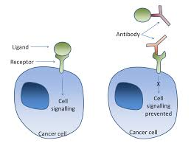
What is a monoclonal antibody (mAb)?¹
mAbs are identical proteins that target cancer cells and their support mechanisms
  mAbs block growth signals or target cancer cells for attack
  The menagerie of antibodies produced by your immune system against infection act in the same way
mAbs must be administered by intravenous infusion because proteins are broken down in the stomach
New Zealand Cancer Society. Treatment for advanced cancer. Available at: https://otago-southland.cancernz.org.nz/cancer-information/living-with-cancer/advanced-cancer/treatment/#Monoclonal.

Slide 38
What happens after first-line therapy?
A second-line treatment option may be necessary if:
  The tumour progresses (grows) after first-line therapy
  The side effects of first-line therapy are not well tolerated
Oncologists may choose to switch chemotherapy and/or
targeted therapy options
of patients with metastatic bowel cancer will receive
≥2 lines of treatment
Stein A, Bokemeyer C. World J Gastroenterol 2014;20:899–907.

Slide 39

Surgery for metastatic bowel cancer^{1,2}
Surgical removal of the primary (bowel) tumour
Bowel surgery is a major operation and is not suitable option for all patients
The primary tumour may be removed if there is a risk of complications, such as the tumour:
  Blocking the bowel
  Growing outside of the bowel and into other organs
Gulack BC. Dis Colon Rectum 2016;59:299–305.
Bowel cancer New Zealand. Metastatic bowel cancer. Available at: http://beatbowelcancer.org.nz/about-bowel-cancer/metastatic-bowel-cancer/.

Slide 40

Surgery for metastatic bowel cancer
Surgical removal of metastases
Medical treatment can be combined with surgery
to resect (cut out) metastases in some patients
Feasibility depends on a number of factors,
including the size and location of metastases
Dhir M, Sasson AR. J Oncol Pract 2016;12:33–39.
Bowel cancer New Zealand. Metastatic bowel cancer. Available at: http://beatbowelcancer.org.nz/about-bowel-cancer/metastatic-bowel-cancer/.

Slide 41
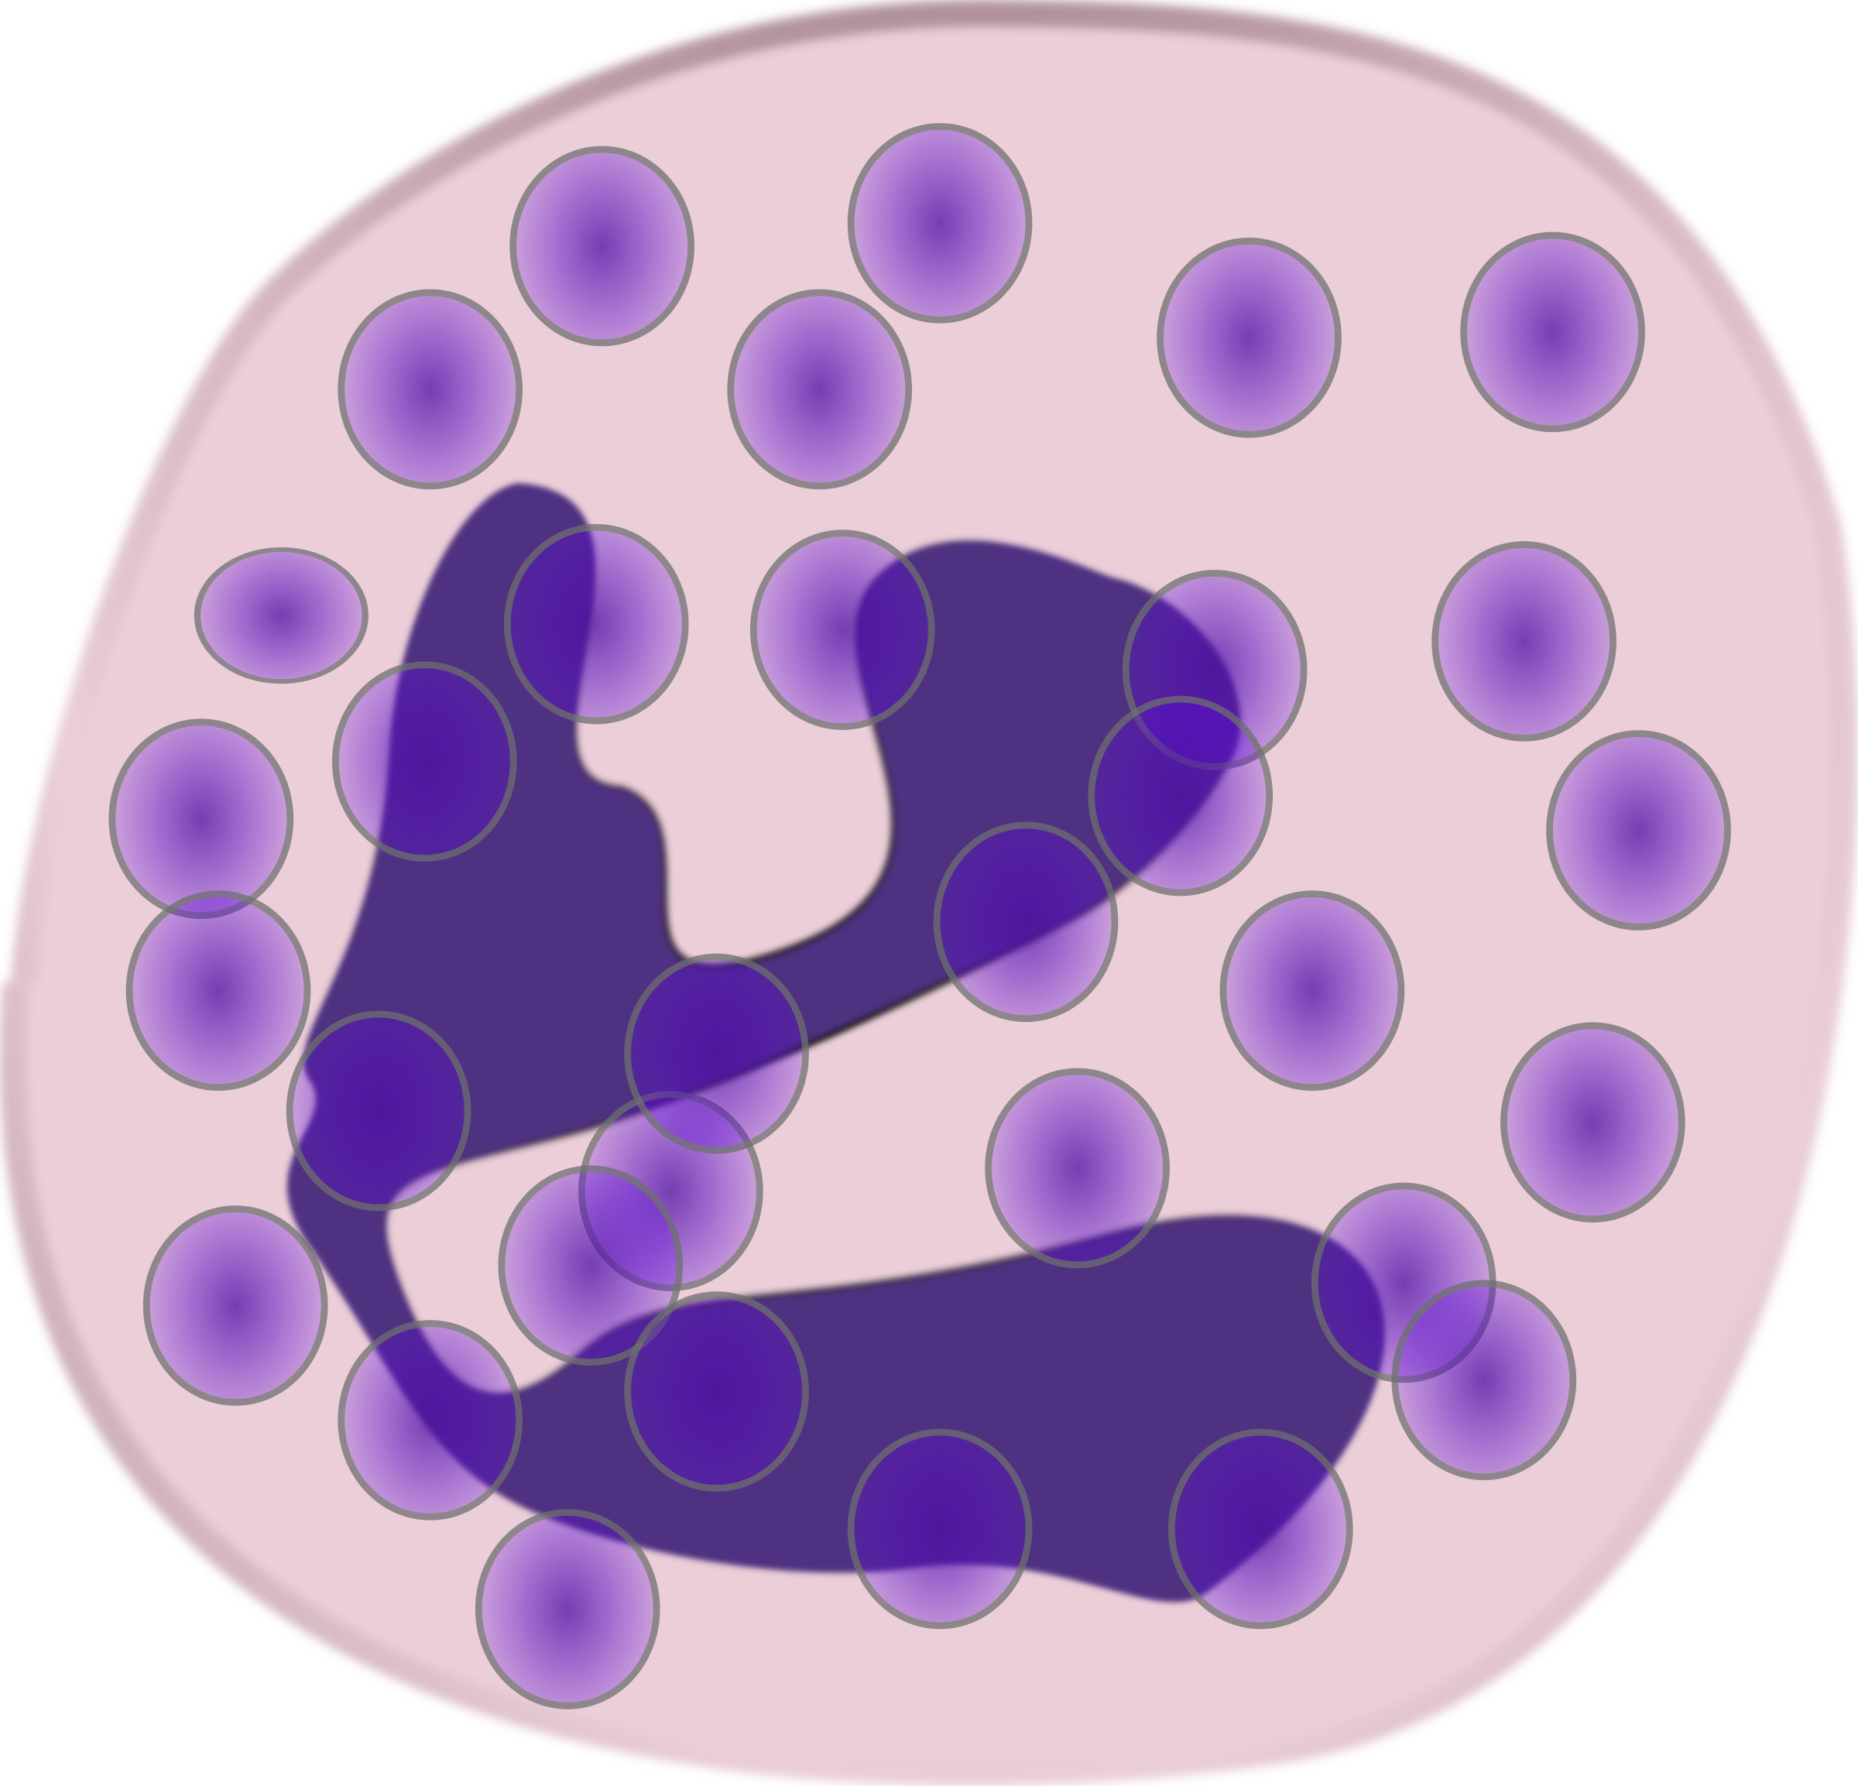
The future of bowel cancer treatment: Immunotherapy
Immunotherapy involves treatments that enhance
or supress a patient’s immune system, allowing
it to better combat disease
  Examples include pembrolizumab (KEYTRUDA®)
  and nivolumab (OPDIVO®)
Research into immunotherapy for bowel cancer is in its early stages, but results are promising
Boland PM, Ma WW. Cancers (Basel) 2017;9:50.

Slide 42



Living with bowel cancer
A diagnosis of bowel cancer can have significant implications
beyond life expectancy and treatment effects:
Emotional – including body image
Dietary changes
A colostomy bag may be required following surgery
and the stoma (opening) will require management
Beating Bowel Cancer. Living with bowel cancer. Available at: https://www.beatingbowelcancer.org/understanding-bowel-cancer/living-with-bowel-cancer/.

Slide 43
Reducing the risk of bowel cancer

Slide 44
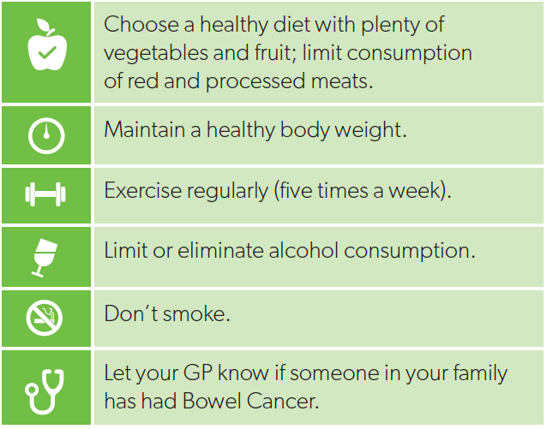
How can I reduce my risk of bowel cancer?
While no cancer is completely preventable, you can lower your risk of bowel cancer by eating a healthy diet and exercising regularly
1. Richardson A. NZ Med J 2016;129:13–20.
Notes:
While you can’t do anything about genetic risk factors and personal/family history, there are modifiable risk factors that can be addressed to reduce your chance of bowel cancer

Slide 45
There is help available
While it is important to speak to your GP or specialist, there are a number of other services available:
  www.beatbowelcancer.org.nz
  https://www.health.govt.nz/
  Call 0800 924 432 for information about
  the Bowel Screening Programme
Get involved!
  Bowel Cancer Awareness Month (June each year)
  Decembeard

Slide 46



Thank you to our sponsors
While we are aware that there are additional sponsors noted on your website, we have only included those acknowledged in the brochure provided
We’ve also dropped our own logo in :-)

